Slide 1
Russian space exploration

Slide 2
Read the words
The International Space Station,
construct, single, twin cabins
microgravity, spacesuit, era,
spaceship, exploration, fully equipped,
emergency, orbited, launched, solar.

Slide 3
Answer the questions
Where would you like to go in space?
What would you like to do there?
Who is your Russian space hero or heroin?
Would you like to be a cosmonaut?

Slide 4
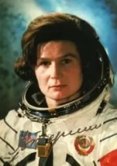
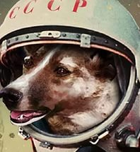
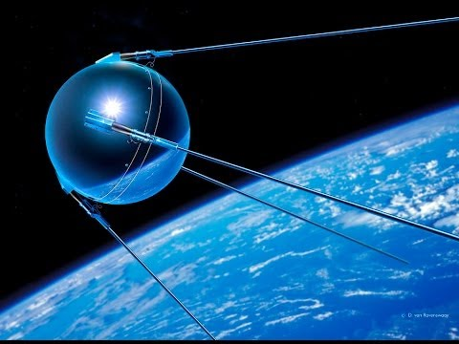
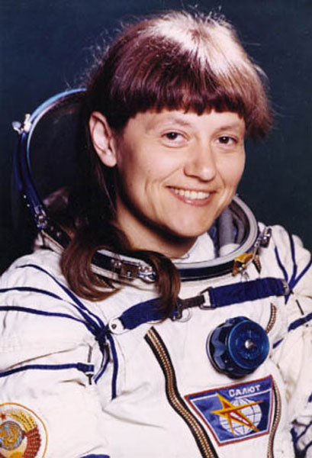
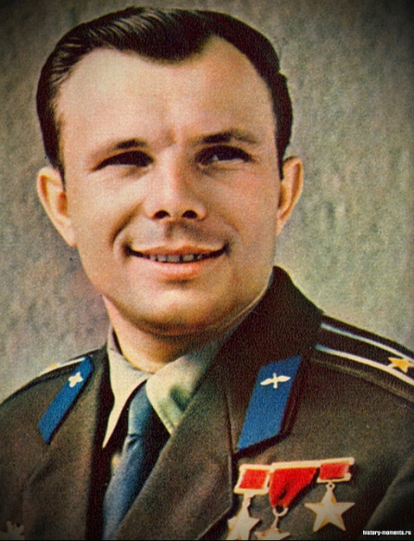
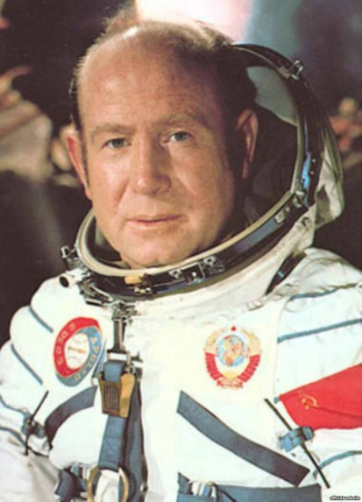
Match
1957 1963
1961 1984 1965

Slide 5
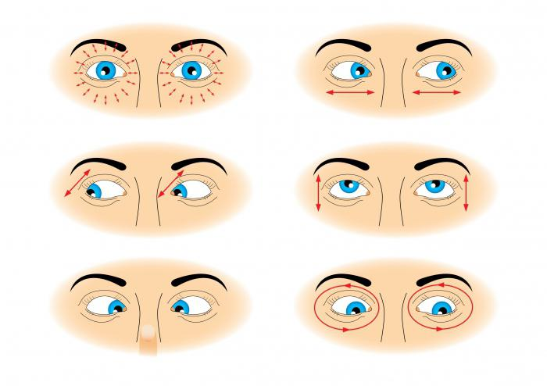
Dynamic pause
Move with your eyes

Slide 6
1.
Dubna
Russia
1. Your Address
2.
Dubna
Russia
3.
4.
5.
6.
7.
8.

Slide 7
1.
Dubna
Russia
2. Date
12.06.2014
2.
12.06.2014
3.
4.
5.
6.
7.
8.

Slide 8
1.
Dubna
Russia
3. Greeting
12.06.2014
2.
Dear Jane,
Dear Jane,
3.
4.
5.
Don’t forget to write down the comma!
6.
7.
8.

Slide 9
1.
Dubna
Russia
4. Introduction
2.
12.06.2014
Dear Jane,
You usually:
a) thank your friend for the received letter:
Thanks for …,
Many thanks for …,
How nice of you to …,
I am awfully glad to get your letter…
Thanks a lot for …
3.
Thanks a lot for your letter.
4.
5.
6.
7.
8.

Slide 10
1.
Dubna
Russia
5. Main Body
2.
12.06.2014
Dear Jane,
3.
- Answer 3 questions in detail.
Don’t forget to use Linking Words:
but, and, because, as, Well,
Anyway,
To my mind,
Thanks a lot for your letter. Sorry I couldn’t write earlier, but I was very busy at school. How are you getting on?
4.
5.
6.
7.
8.

Slide 11
1.
Dubna
Russia
6. Conclusion
2.
12.06.2014
Dear Jane,
3.
write something that sums up your previous details.
Sorry, I must finish now because …
I’ll write again soon.
Hope to hear from you soon.
Drop me a line.
Write to me as soon as possible.
Thanks a lot for your letter. Sorry I couldn’t write earlier, but I was very busy at school. How are you getting on?
4.
5.
6.
Well, that’s all for now. Loads of homework!
Hope to hear from you soon.
7.
8.

Slide 12
1.
Dubna
Russia
7. Ending
2.
12.06.2014
Dear Jane,
3.
Best wishes,
All the best,
- Yours,
Thanks a lot for your letter. Sorry I couldn’t write earlier, but I was very busy at school. How are you getting on?
4.
5.
Don’t forget to write down comma after the phrase!
6.
Well, that’s all for now. Loads of homework!
Hope to hear from you soon.
Best wishes,
7.
8.

Slide 13
1.
Dubna
Russia
2.
12.06.2014
8. Signature
Dear Jane,
3.
Thanks a lot for your letter. Sorry I couldn’t write earlier, but I was very busy at school. How are you getting on?
4.
Write down ONLY your name!!!
Don’t write down full stop!
5.
6.
Well, that’s all for now. Loads of homework!
Hope to hear from you soon.
Best wishes,
7.
Kate
8.

Slide 14
Home task
Write your English pen-friend a letter.
The first group: «Russia‘s history in space»
The second group: «My favourate Russian space hero or heroine»
The third group: «Would you like to be a cosmonaut? Explain why(not)».

Slide 15
Источники:
https://yandex.ru/images/search?text=динамическая%20пауза&parent-reqid=1485848132392429-779572830988742335287802-sas1-5626
http://4ege.ru/angliyskiy/52338-pravila-napisaniya-pisma-na-angliyskom-yazyke.html
https://yandex.ru/images/search?text=русские%20в%20космосе

